Slide 1
We hope our patients can be reassured that as a research active practice we are forward thinking and strive to do our best for them.

Slide 2
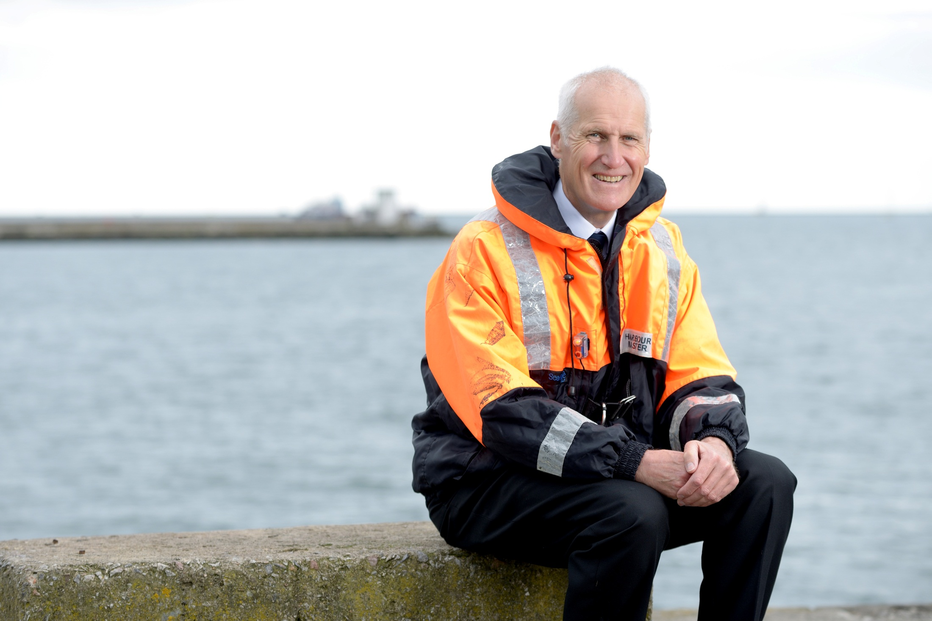
Research helps us find evidence-supported answers
“It is in everyone’s interest to support and achieve advances in health care.”
Tim Charlesworth,
Parkinson’s research participant
to improve treatments and quality of life for patients now and in the future

Slide 3
Clinical research can focus on
Promoting a healthier lifestyle
Disease prevention
Disease diagnosis
Treatment of common ailments
Management of long term health conditions

Slide 4
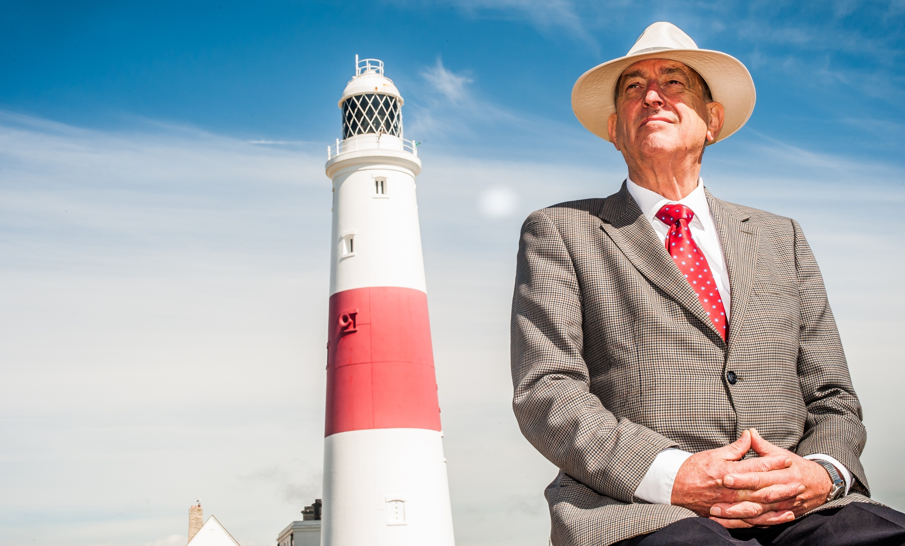
"Being a study participant switched from a passive stance to an active one and the research was like a lighthouse in a confused sea."
Peter Stamp,
South West diabetes research participant
Taking part in research can be Empowering

Slide 5
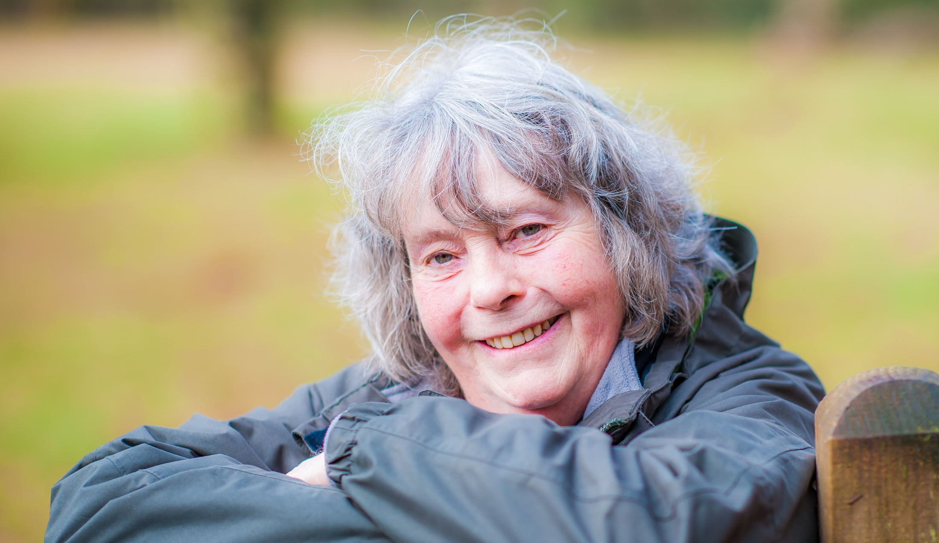
“By taking part in research studies I know my condition is monitored very closely which gives me peace of mind.”
Chrissie Mortimer, Research participant
Taking part in research can be Reassuring

Slide 6
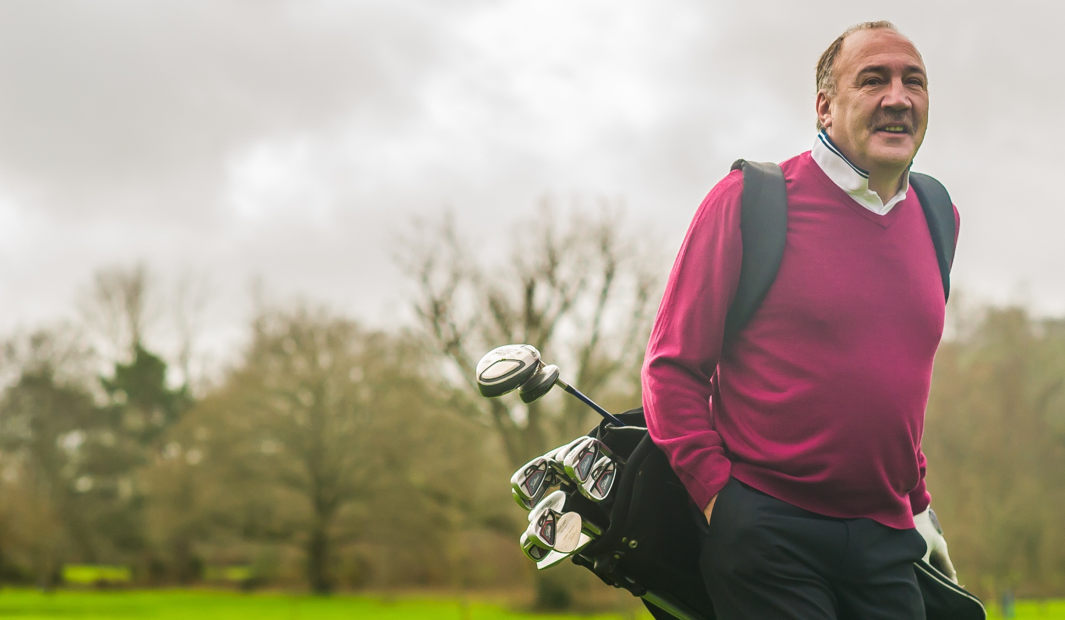
“It feels good knowing this research has the potential to benefit others, particularly children, in the future.”
Stephen Underwood, Research participant
Taking part in research can be Rewarding

Slide 7
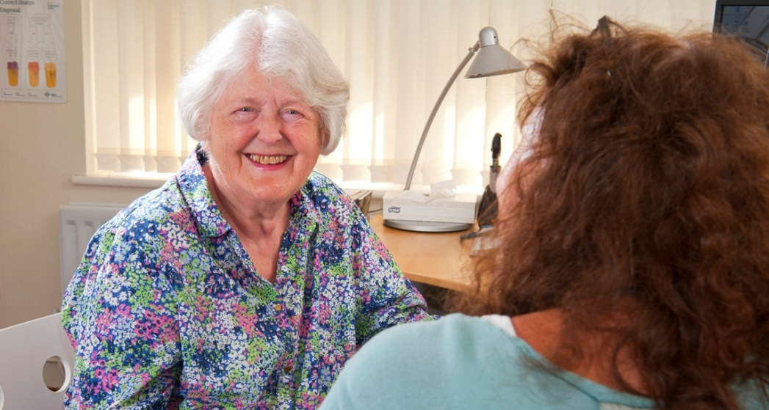
"Taking part in health research is my way of saying thank you - giving back to the NHS which has looked after me so well all my life."
Anne Walsh-Waring,
Renal research participant
Over 21,300 people took part in clinical health research studies in the South West (2015-16)

Slide 8
We would love to know if you or someone you care for would be interested in supporting health research at this practice.

